Slide 1
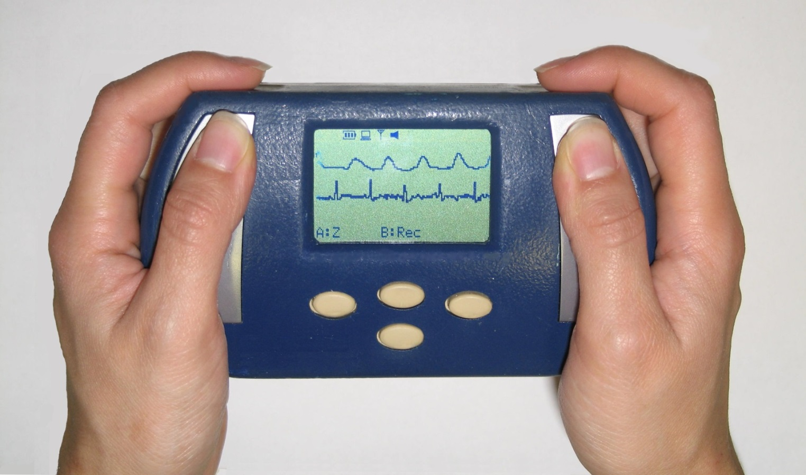
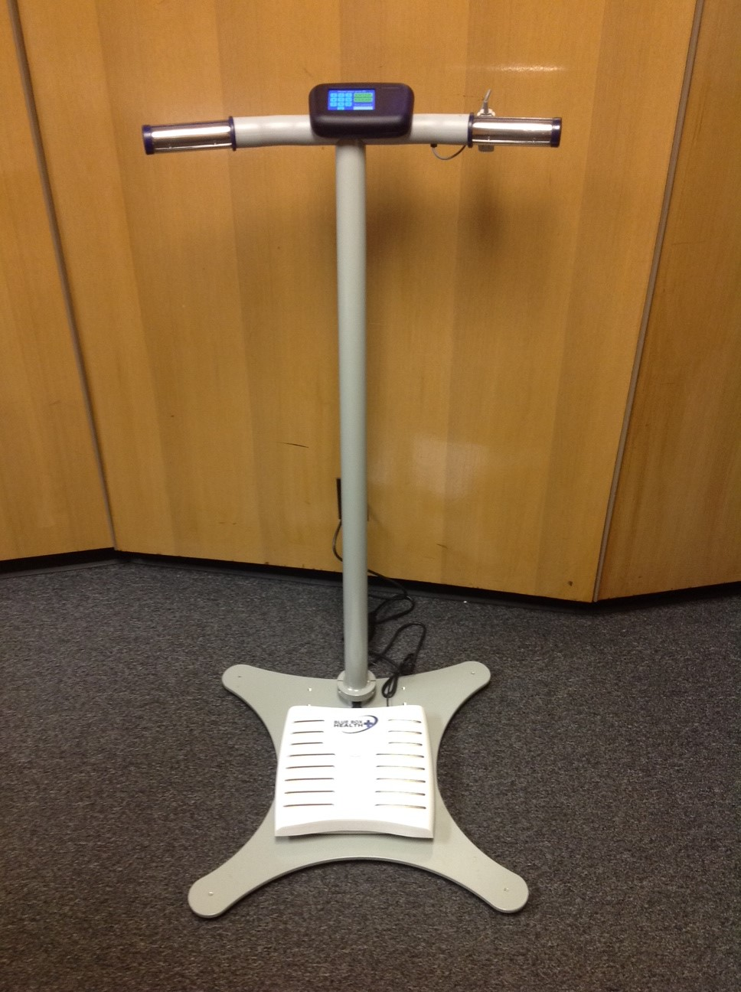
BLUE SCALE: A MULTISENSING DEVICE FOR REMOTE MANAGEMENT OF CONGESTIVE HEART FAILURE
Luca Pollonini^{1,2}, Sadia Quadri³, Joe Chen³, Jennifer Ding³, Zongjun Zheng³,
Sharan Naribole³, Kara K. McArthur², Edward W. Knightly³ and Clifford C. Dacso^{1,2,3,4}
¹ Department of Engineering Technology – University of Houston, TX; ² Abramson Center for the Future of Health – University of Houston, TX;
³ Department of Electrical and Computer Engineering – Rice University, Houston, TX;⁴ Department of Cellular and Molecular Biology and Medicine, Baylor College of Medicine, Houston, TX
Background and Aim
Device Features and Deployment
Congestive heart failure (CHF) is a chronic illness in which effective management requires continuous and consistent monitoring of cardiovascular parameters.
Since CHF patients monitor their cardiac health only when they visit an ambulatory or emergency care facility, remote self-measurements has great potential for efficient management of CHF.
Handheld device BlueBox measured ECG and PPG remotely, but it suffered from usability and connectivity drawbacks that limited its applicability in larger scale studies.
Second-generation Blue Scale provides a user-friendly interface paired to improved physiological sensing and connectivity.
Blue Scale allows seamless daily monitoring for early detection of degrading cardiovascular health, particularly in elderly and underserved populations.
Blue Scale measures 3-lead ECG, PPG, whole-body bioimpedance and weight. Systolic time intervals are computed as pulse transit times (PTTs).
Dataset is transmitted via Wi-Fi to a central database and processed into meaningful metrics, such as RR variability, QRS time, and PTTs, among others.
CHF management is based on the analysis of individual historical data to detect a significant deviation from that patient’s daily norm.
Three prototypes of Blue Scale were deployed in the Houston area. Twenty-two healthy volunteers took daily measurements with the scale for anywhere between one and four weeks following an IRB-approved protocol.
Results
Early results indicate a much improved usability, yielding a high adherence rate, and higher quality of the physiological signals over the handheld BlueBox device.
Participants suggested providing a daily feedback of cardiovascular health to maintain adherence over time.
Preliminary algorithms successfully detected cardiac anomalies simulated artificially.
+ USABILITY
+ SENSING
+ CONNECTIVITY
Acknowledgements
This work is supported by NSF grants CRI/IAD 0751173 and CNS-1012831.

